Slide 1

Customizing ranges and colors in the FAERS summary table
Critical safety insights from post market data
Marnix Wieffer, PhD, MBA
Senior marketing manager drug safety
Notes:
Hallo everybody and welcome to this tutorial video on how to Customizing colours and ranges in the FAERS summary table
This will help you to identify and highlight For example, you can highlight:
The high incidence of an adverse events caused by drugs and drug classes
Difference in incidence of adverse events between drugs and drug classes
Subpopulation trends that may otherwise not be apparent

Slide 2
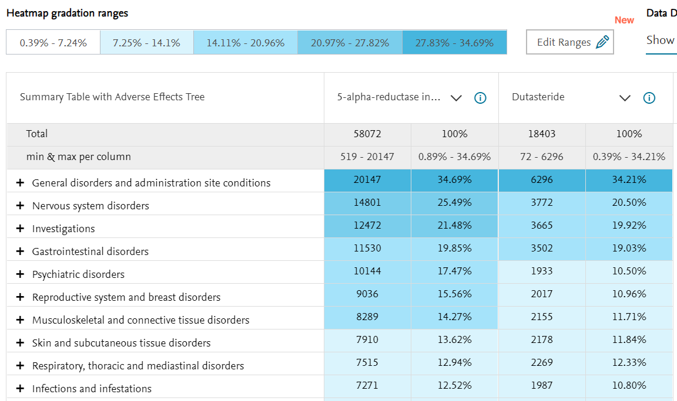

Example question
Default view
  “What is the difference in incidence of the most common observed adverse effects of Dutasteride and the class of 5-alpha-reductase inhibitors in post-market data?
Recommended watch:
Finding post-market adverse event data using the Summary Table and Graphical View option (7 min)
Notes:
For this tutorial, let’s assume we are developing a new 5-alpha-reductase inhibitor. The currents standard if care is the 5-alpha-reductase inhibitor Dutasteride. Now we would like to know “What is the difference in incidence of the most common observed adverse effects of Dutasteride and the class of 5-alpha-reductase inhibitors in post-market data? This gives us crucial competitive information and critical insights into the adverse events we can anticipate for our drug under development. If you are new to FAESR searching, it is recommended to watch the video Finding post-market adverse event data using the Summary Table and Graphical View option (7 min) first.
In that video we show you in detail how to build a default heatmap view of absolute and relative incidence of post post-market adverse event data. As you can see the default view is blue, where dark blue indicates high incidence, and light blue indicate low incidence.
Now lets modify the ranges and colors to identify and highlight the data most relevant to us.

Slide 3
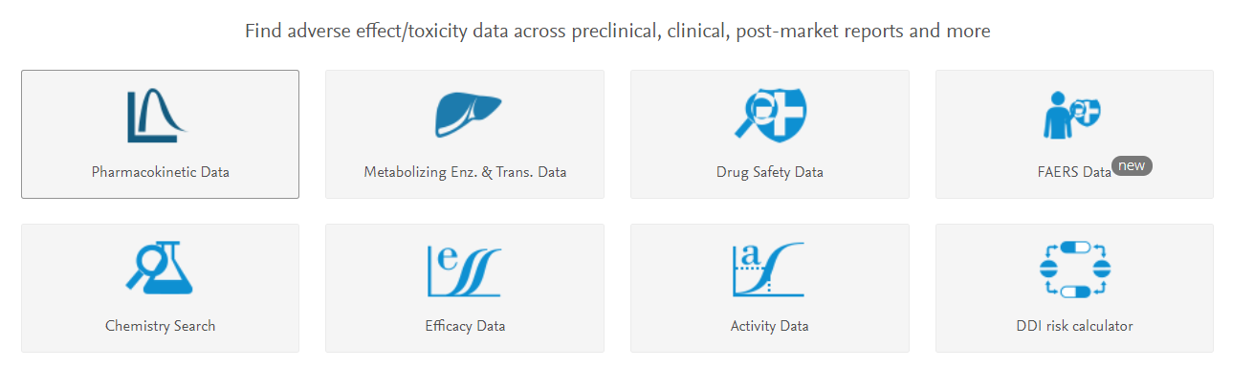
How to customize colors of the heatmap?
Select the FAERS module
Notes:
To answer this question, w go to the FAERS data search module……

Slide 4
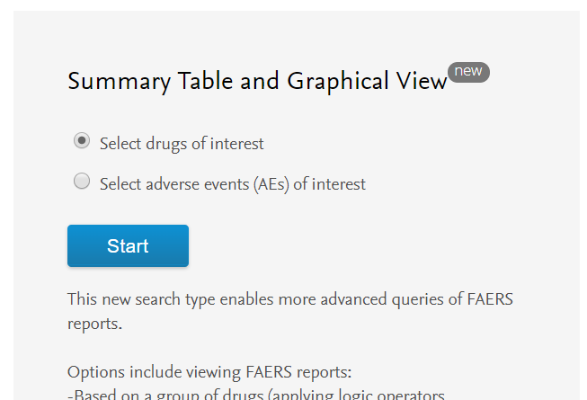
How to customize colors of the heatmap?
1. Select “drug of interest”
2. Select “start”
Notes:
Under Summary table view and graphical view select “drug of interest”. You can of course also adjust the range and colouring of a summary table staring with an adverse event search

Slide 5
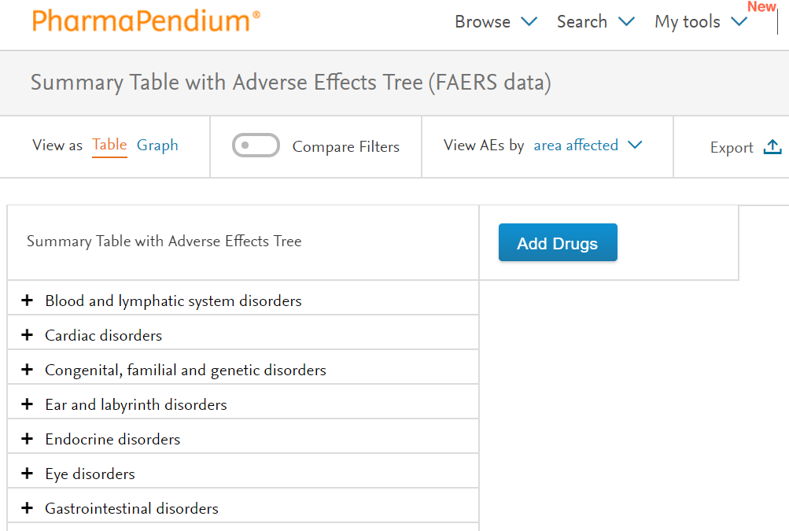
Add drugs to your table
2. Select “add drugs”
Notes:
Let’s select add drugs…,.

Slide 6
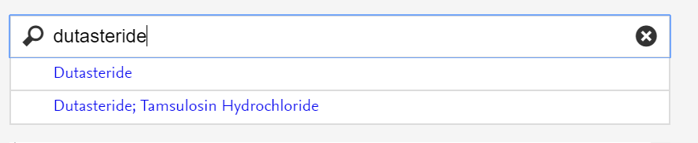
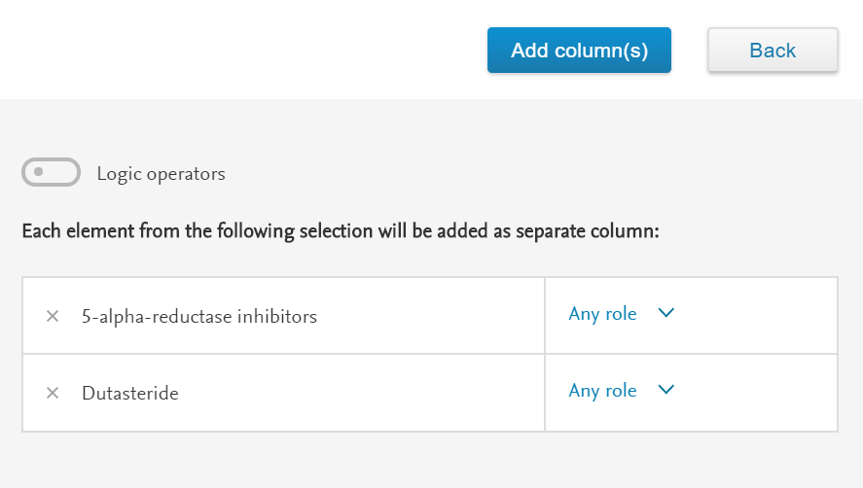
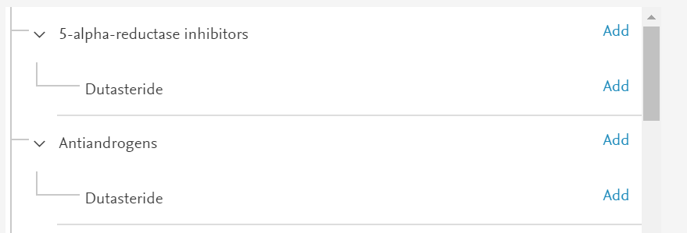
Select drugs/drug classes of interest
1. Search drug and/or drug class of interest
3. Select multiple drugs/drug classes if relevant and select ”add columns”
2. Click “add”
If relevant, add groups and roles
Notes:
And add Dutasteride and 5-alpha-reductase inhibitors

Slide 7
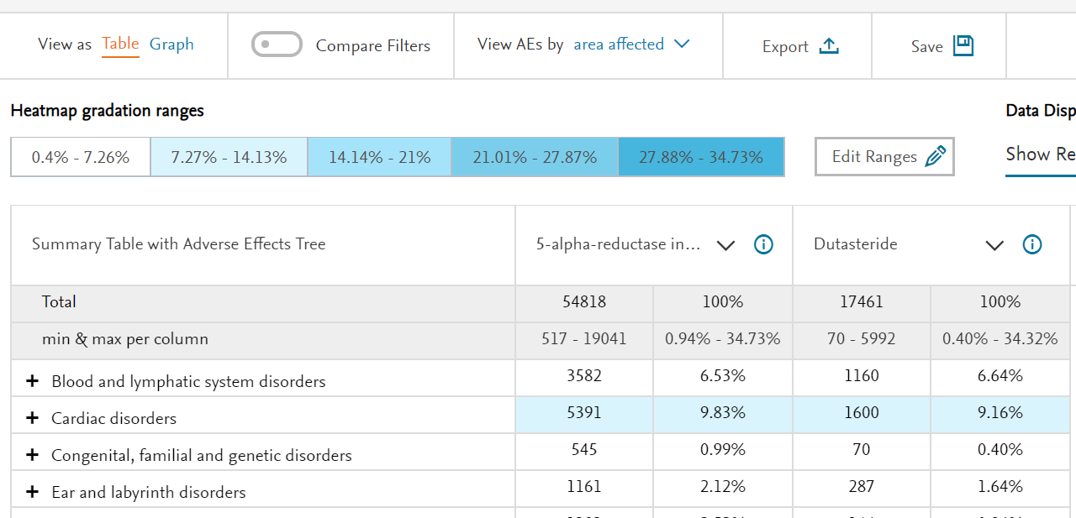
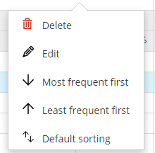
If relevant: sort on frequency
Notes:
If relevant, you can sort the data according to Frequency

Slide 8
How to customize of the adverse event table ?
1. Select “Edit ranges”
Notes:
To modify the range and/or color, you click on edit ranges………….

Slide 9
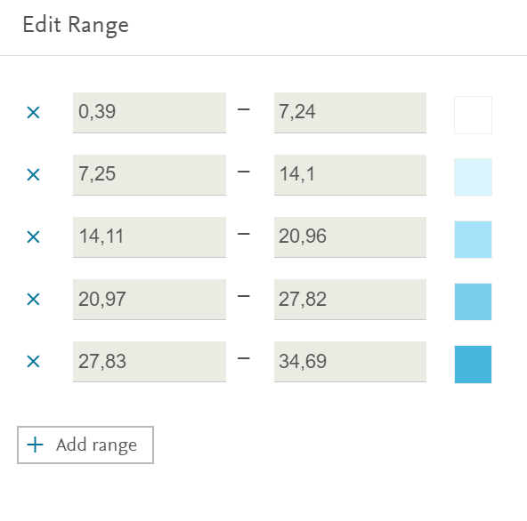
What defines the default size of buckets?
Pregnancy, puerperium and perinatal conditions
Default size of buckets is:
(highest percentage - Lowest percentage)/5
In this example: 6,86%
General disorders and administration site conditions
Notes:
This will open up the popup that will tell the color and range of each bucket,

Slide 10
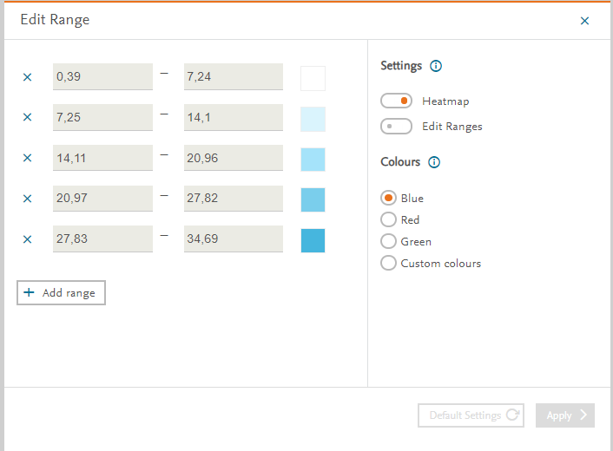
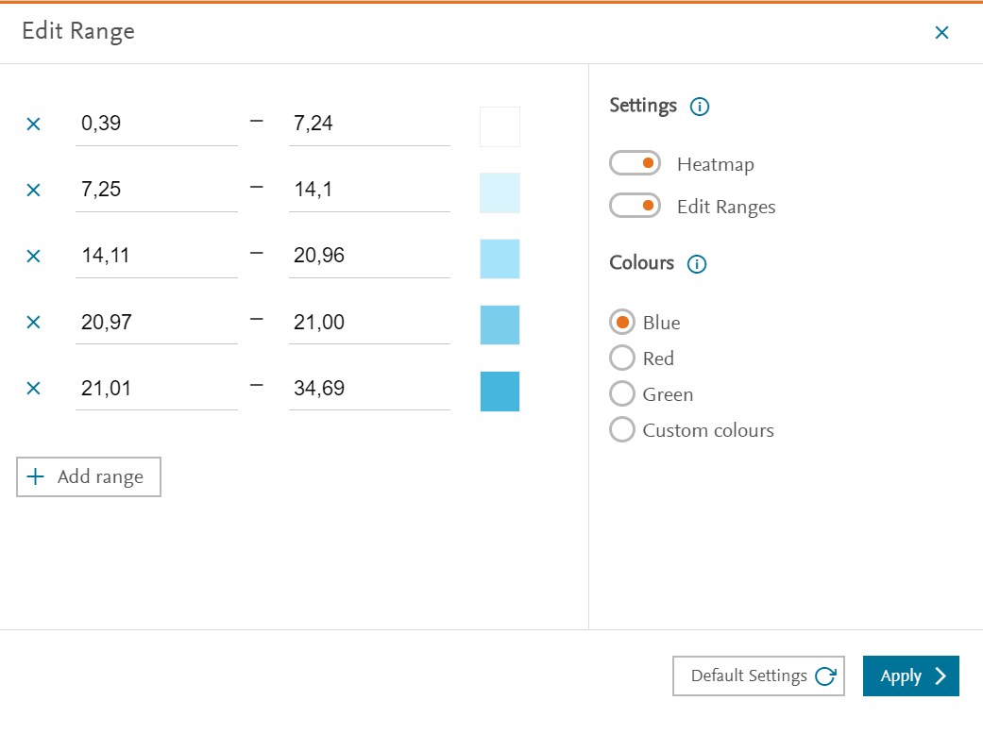
How to customize ranges
Select edit ranges
Change ranges

Slide 11
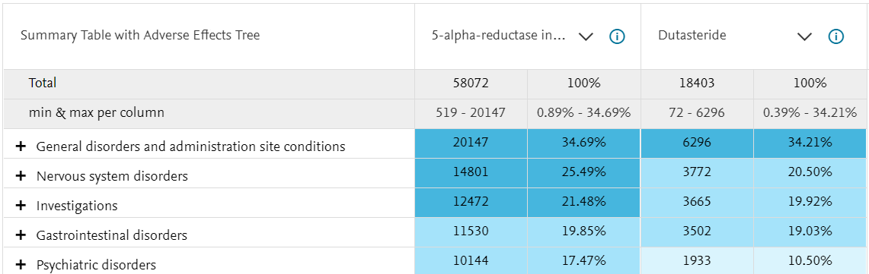
The results
Old ranges
new ranges

Slide 12
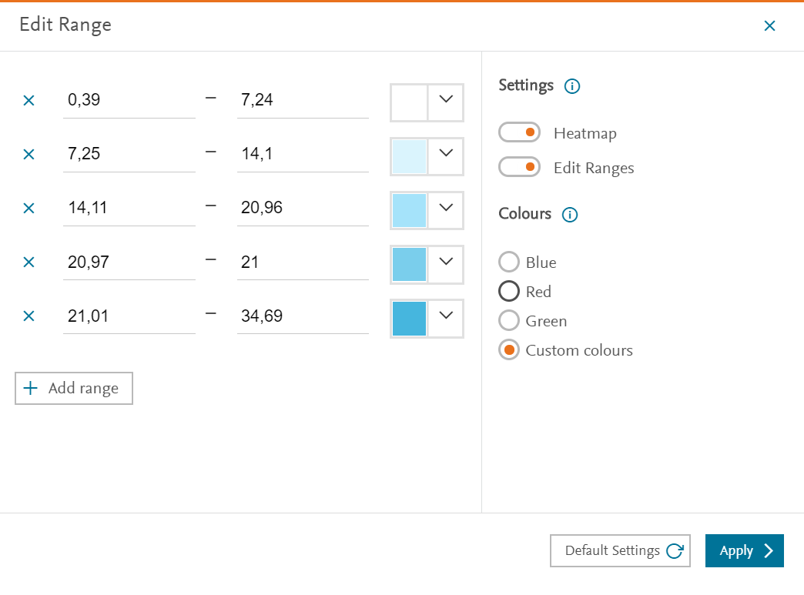
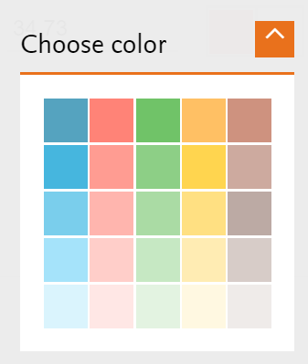
How to customize colors of the heatmap?
1.Select customize colors
2.Select color of interest
3.Select apply

Slide 13
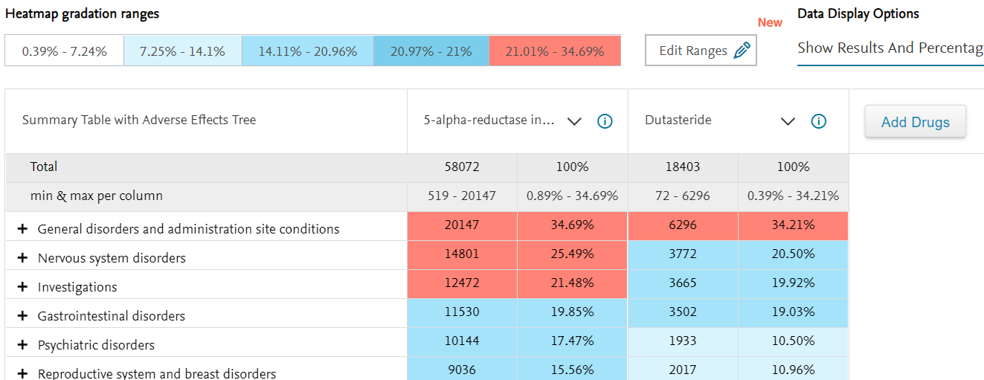
Results: Visual highlighting of adverse effects for a drug class vs a drug of that class
Visual highlighting of adverse effects of a class of drug vs a drug of that class
Notes:
Using this example, I have show you how you can update ranges and visually highlight the most relevant data. This can helps you to identify the most relevant data quickly and support the focusing of attention on the data that is most important.

Slide 14
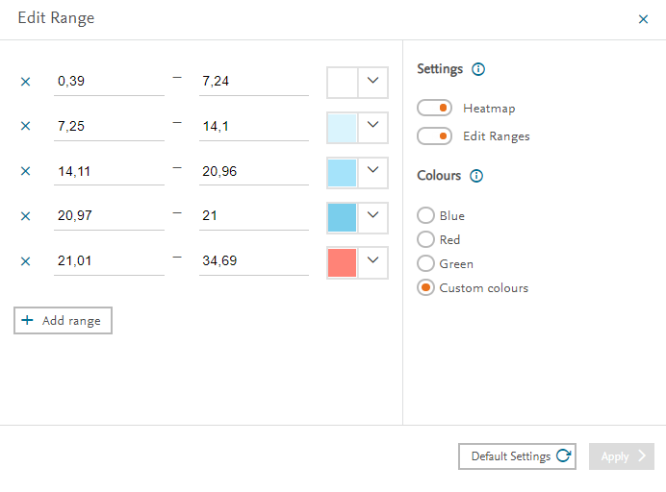
Return default settings
Return default setting s
Notes:
If you would like to return to default setting you can simply click on

Slide 15
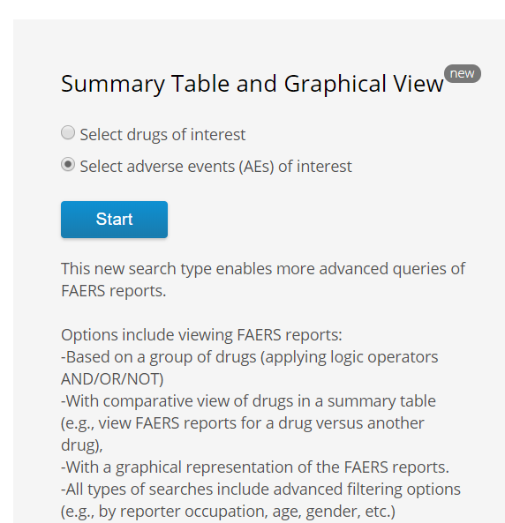
You can also start a search with an adverse event
What drug classes have the most post market reports for Migraine headache?

Slide 16
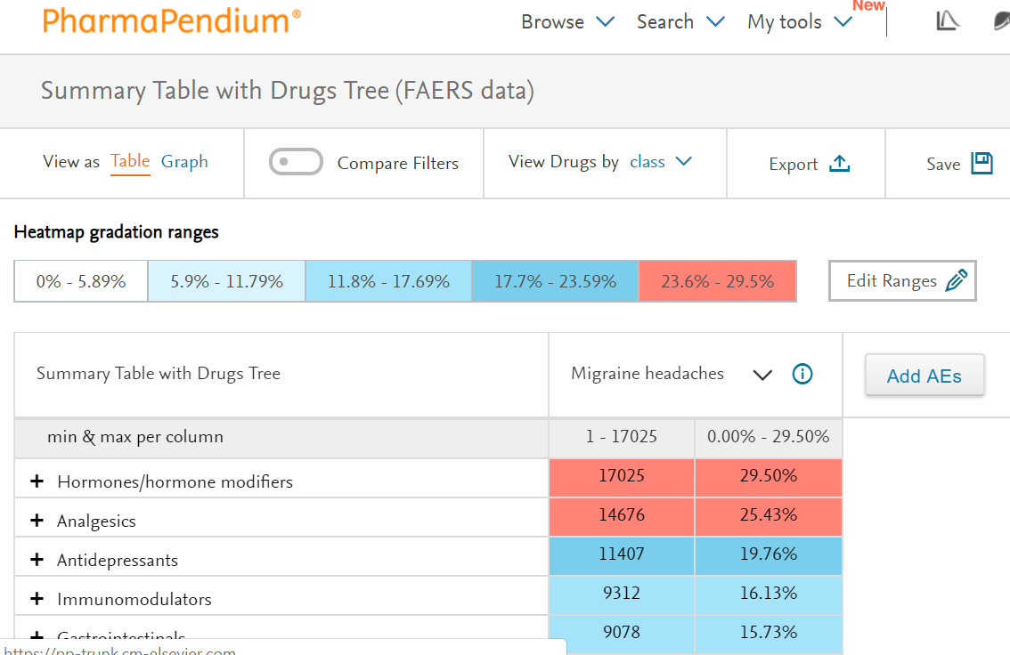
You can also start a search with an adverse event
Migraine headaches are most commonly observed in the drug classes hormones/hormone modifiers and analgesics

Slide 17
Marnix Wieffer
Notes:
With that I would like to thank you for you attention, in case of any questions, please do not hesitate to get in touch.

